Slide 1
Quarterly Update on the National Inventory Collaborative
June 26, 2019

Slide 2
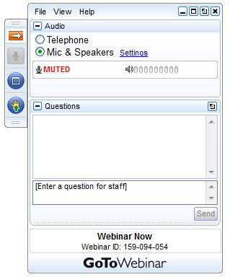
Webinar Ground Rules: Questions?
Each workgroup will give a ~5 minute update describing their work over the last quarter and their plans for the coming months.
All call participants will remain on mute during the webinar.
Type your questions into the question box on the webinar client.
We will try to answer questions at the end of the webinar.
We will create a Q&A document following the webinar and post with the meeting notes on the Collaborative Wiki: http://views.cira.colostate.edu/wiki/wiki/9169

Slide 3
Overview of the Platform Collaborative
A new multi-purpose emissions modeling platform (EMP) based on the 2014 National Emissions Inventory version 2 (2014NEIv2) is needed
  State Implementation Plans, federal analyses
  For the first time, EPA, states, and MJOs are engaging in collaborative EMP development
  The 2016 base year was selected via a collaborative process
Future years selected due to regulatory relevance
  2023 is relevant for Ozone NAAQS moderate areas
    2020 is being created by some states/regions for 2008 O3 NAAQS attainment demonstration modeling
  2028 for regional haze

Slide 4
2016 EMP Schedule
Several versions of 2016 platform will be developed
  Alpha: preliminary version based on 2014NEIv2 for some and 2016 for other key sectors (released Spring, 2018)
    For initial testing of 2016 model runs
    Compatible versions of 2014 and 2015 were also released
    https://www.epa.gov/air-emissions-modeling/2014-2016-version-7-air-emissions-modeling-platforms
  Beta: improved and/or new version of actual 2016 emissions for most sectors (March 2019) and preliminary projected emissions for 2023 and 2028 (to workgroups in April 2019)
  V1.0: fully updated 2016 emissions and complete projected emissions for 2023 and 2028 (Summer 2019)

Slide 5
Organizational Structure
Coordination co-leads: Zac Adelman (LADCO) and Alison Eyth (EPA OAQPS)
  Developed process and communication structures, facilitate discussions, help resolve issues, documentation requirements, coordinate distribution of data to stakeholders
Coordination committee: regional, state, EPA leaders
  Define processes, resolve issues, co-lead workgroups
  Includes overall and WG co-leads plus MJO directors
Sector-specific Workgroups: one regional/state staff and one EPA staff (where possible)
  Focus on preparing emissions estimates for 2016 and future years, plus improve how the emissions sectors are modeled
  Include participants from EPA/states/locals/regions

Slide 6
Objectives of Today’s Webinar
2016 beta release: use cases, received comments
Present the plans for the version 1 release, including data updates and schedule

Slide 7
2016 beta Release Schedule
Release Date: March 13, 2019
  See http://views.cira.colostate.edu/wiki/wiki/10197
  AQM-ready data and all SMOKE inputs are available from the Intermountain West Data Warehouse (IWDW)
2016 beta base year release contents
  2016 inventories for all anthropogenic sectors, fires, and MEGAN and BEIS3 biogenic emissions
  CMAQ and CAMx-ready emissions at 36km and 12km
  SMOKE ancillary data and scripts for 2016
  Documentation
  Interactive charts and maps at IWDW; static charts and maps at LADCO
2016beta projections to 2023 and 2028 released to workgroups in April 2019
Comments collected through May 31, 2019

Slide 8
2016beta Known Use Cases
Some of these may be for ongoing applications and others downloaded beta to review prior to 2016v1
OTC state modeling (NY)
SIPs (NC, Clark County, MD)
Attainment demonstration (Denver)
Regional haze (Texas, HAQAST, EPA)
AQ Forecasting system (NOAA ARL)
EPRI analyses of AQM responsiveness (GA Tech)
EDF modeling (UNC)
Other Analyses (CT, Louisville KY, NC State University, Sonoma Tech)
Post-call survey to request v1 use cases

Slide 9
Collaborative Workgroup Reports
EGUs
Non-EGU Point
Nonpoint
Oil and gas sources (point and nonpoint)
Onroad
Nonroad
Rail
Commercial Marine Vessels (CMV)
Biogenics
Fires
Modeling
Wrap up
Wiki has more information and notes from each workgroup
  http://views.cira.colostate.edu/wiki/wiki/9169

Slide 10
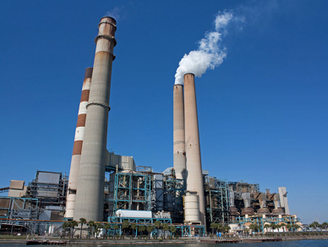
Electricity Generating Units (EGU) Workgroup
Co-leads: Julie McDill (MARAMA), Serpil Kayin (EPA CAMD), Alison Eyth (EPA OAQPS)
Schedule: Calls 4th Thursday at 2:00pm ET
Wiki: http://views.cira.colostate.edu/wiki/wiki/9174

Slide 11
EGU Workgroup: 2016v1
Base Year Approach
  Only a few updates planned from beta to v1
Comments on beta
  Data on NJ and Alaska EGUs
  Updates to temporal profiles for some EGUs without CEMS in MARAMA states
  Various comments from VA
Differences from beta
  Base Year (2016): EGU emissions and temporal profiles will be updated to address as many comments as possible
  Projection Years: Updated versions of data for both ERTAC and IPM will be available
Milestones
  Expected release date: September 2019

Slide 12
EGU Workgroup: ERTAC-EGU
Runs with new inputs of CONUS v16.0 complete
  Current: v16.0/beta
  Minor updates to v16.0 expected for 2016 v1
    SE growth factors will be revised
    Tweaks to documentation
  Years:
    Base Year 2016
    Future Years 2020, 2023, 2028
    Other years if needed
  CSAPR-compliant, meets state assurance levels
Next steps
  Focus on training through the summer
  Expect to develop v16.1 in the fall
    State outreach
    Updated growth factors (all)
    Updated shutdowns, control

Slide 13
EGU Workgroup: ERTAC-EGU
Feedback from states
  Split = ERTAC EGU, “small EGU”, point nonIPM.
    Eliminate any double counting
    Confirm that “small EGU” sources are not already covered by non-point
Temporalization
  Concerns about treatment of peaking sources by IPM
    Approach dampens down Peakers
  Still looking for feedback from states about assignment of units as peakers – for both IPM & ERTAC models

Slide 14
EGU Workgroup: IPM
EPA will be updating its Power Sector Modeling Website with new IPM projections (IPM v6 May 2019 Reference Case) including NEEDS, incremental documentation and unit level results for 2023 and 2030. Please visit https://www.epa.gov/airmarkets/clean-air-markets-power-sector-modeling
  EPA gave a presentation at the EGU WG call on 5/23
Updates in new version include
  Additional closures and committed units
  Adjustments to SO2 EFs for coal units
  Updated methodology for PM post-processing

Slide 15
Western U.S. EGU Inventory
EGU Emissions Analysis Project for Regional Haze Round 2 planning project
  Reps from 13 western states and utility operators, rapidly changing sector, coal closures, renewables way ↑
  Determined current baseline year (2018), made 2028 projections (closures, controls, capacity factors, etc.)
  Report & data available, resource to Collaborative EGU WG
  Use data (esp. projections) in National Emissions Modeling Platform?, SMOKE-ready files also available

Slide 16
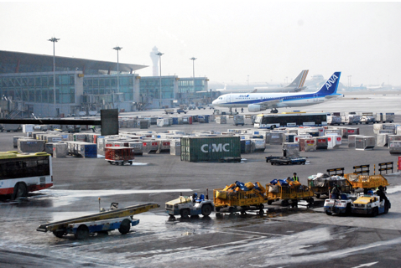
Non-EGU Point Workgroup
Co-leads: Tammy Manning (NC DEQ), Caroline Farkas (EPA)
Schedule: Calls on 3rd Tuesday at 2:00pm Eastern
Wiki: http://views.cira.colostate.edu/wiki/wiki/9177

Slide 17
Non-EGU Point Workgroup
Approach
  Comments submitted by workgroup
  Implementing comments/edits to 2016 base year now
  Changes will mostly be edits on beta projection methods
Base Year:
Comments on beta
  DC replacement inventory
  Closures (VA, MA, NY), closures revoked in NC
  GA anomalies
  NJ applicable controls
  MA State rules and Consent Decrees
Differences from beta
  Comments above addressed
  New aircraft/airport emissions from AEDT model
Milestones
  Expected review date: July 2019
  Expected release date: August 2019

Slide 18
Non-EGU Point Workgroup
Projections:
Comments on beta
  NY factors for ICI Boilers
  DC Controls
  Consent Decrees (NC, MA, NM)
  VA Growth factors
  NJ Growth and Control Factors
  WI growth factors
  NC Growth factors
  AZ Regional Haze new impacted units
  MARAMA growth & control factors
    Including MANEVU sulfur rules, NSPS (NG Turbines, RICE, Process heaters), State rules & consent decrees
Differences from beta
  Comments above addressed
  Growth on aircraft/airports off new AEDT model data
  EIA Annual Energy Outlook updates for growth
Milestones
  Expected release date: August 2019

Slide 19
NonPoint Workgroup
Co-leads: Caroline Farkas (EPA), Jennifer Snyder (EPA)
Schedule: Calls on 4th Monday at 2:00pm Eastern
Wiki: http://views.cira.colostate.edu/wiki/wiki/9178

Slide 20
NonPoint Workgroup
Approach
  Comments submitted by workgroup
  Implementing comments/edits to 2016 base year now
Base Year:
Comments on beta
  NJ growth (2014 to 2016) for afdust, ag livestock, SEDs data for other sources
  NC BoilerMACT controls and growth information
  DC (double check point subtraction)
Differences from beta
  Ag Livestock – will use 2017 NEI counts/emissions (addresses underprediction of dairy cows, poultry)
  Ag Fertilizer – will use 2017 NEI update run with 2016 meteorology
  Afdust – will use 2017 NEI update with 2016 VMT
  Comments above addressed
  SEDs data for state growth from 2014 to 2016 (if possible)
Milestones
  Expected review date: early July 2019
  Expected release date: August 2019

Slide 21
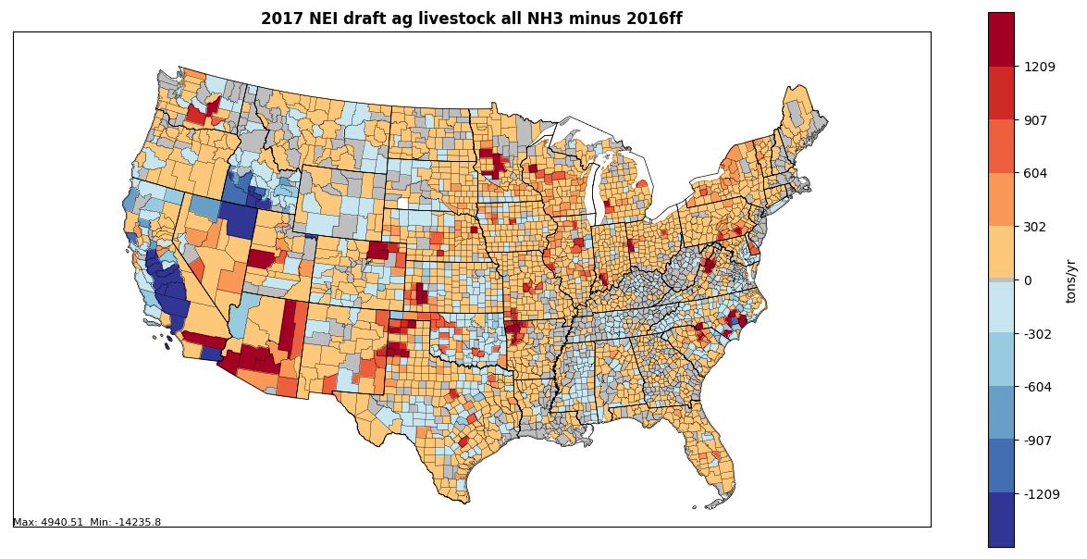
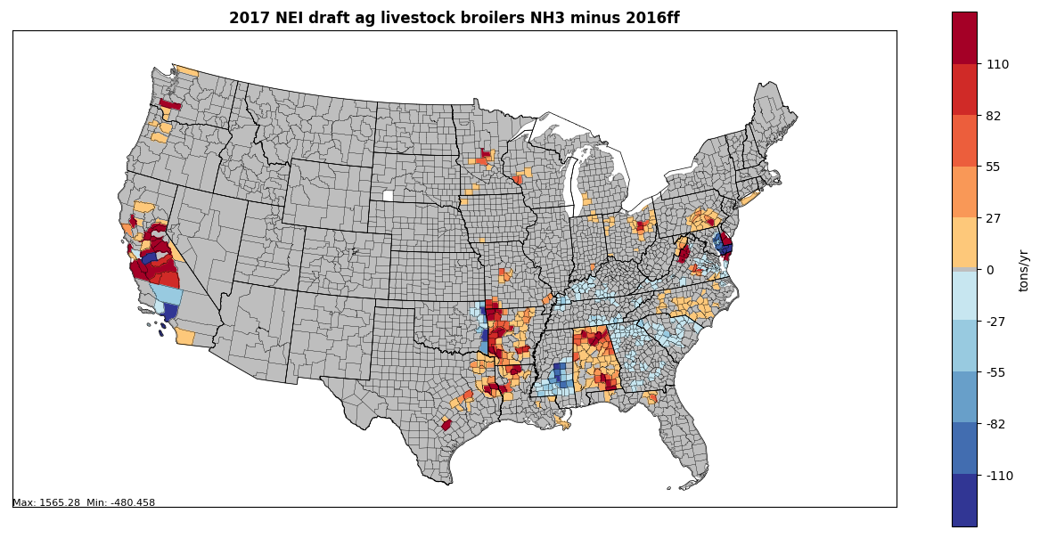
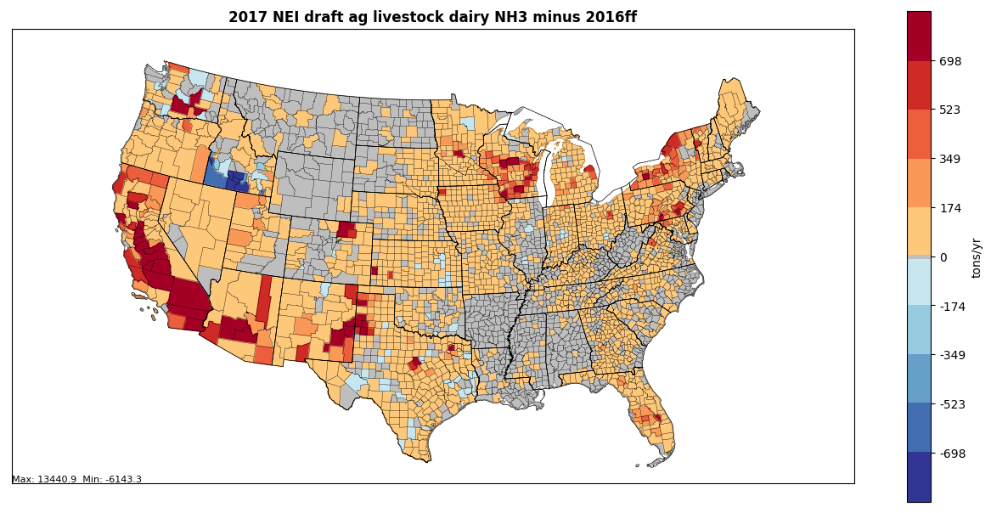
2017 NEI Draft Total Livestock NH3 minus 2016beta
Ag Livestock Emission work for 2016v1
2017 NEI addresses underprediction of Chickens and Dairy Cows
Emissions are being finalized now – due Jul 1st
Plots show emission differences between 2017 NEI draft and 2016beta
2017 NEI Draft Broilers NH3 minus 2016beta
2017 NEI Draft Dairy Cows NH3 minus 2016beta

Slide 22
NonPoint Workgroup
Projections:
Comments on beta
  NJ Growth and Control factors
  NY Growth/Control factors
  PA RACT II Controls
  NC Growth factors
  MARAMA growth & control factors
    Including RICE NSPS
Differences from beta
  Comments above addressed
  EIA Annual Energy Outlook updates for growth
  Growth on new Ag Livestock and Fertilizer emissions
  Looking into using 2017 NEI afdust emissions
  No changes to RWC
Milestones
  Expected release date: August 2019

Slide 23
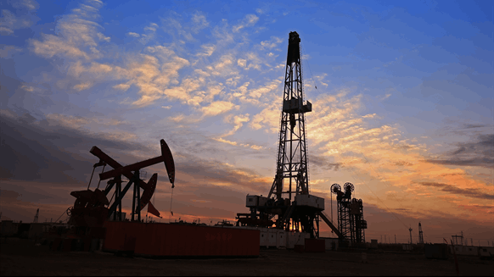
Oil and Gas Workgroup
Co-leads: Tom Richardson(OKDEQ), Jeff Vukovich (EPA)
Schedule: Calls on 2nd Monday at 2pm Eastern
Wiki: http://views.cira.colostate.edu/wiki/wiki/9180

Slide 24
Oil and Gas Emissions Workgroup
Approach
  Update PA and IL non-point base year inventory
  Improve future-year projections where possible
  Incorporate any state/MJO updates
Comments on beta
  LADCO: Illinois VOC emissions seemed much higher than recent years
  NJ: Add control to pipeline compressor(s)
  AK: Comments provided; review under way
Differences from beta: base year
  Pennsylvania provided unconventional well-related emissions
    EPA O&G tool used to generate conventional well-related emissions
    Impact: NOx up 16K tons and VOC down 56k tons
  Illinois provided updated active well information
    48K active wells assumed in 2016beta but actual active wells about 20K
    Impact: NOx down 14k tons and VOC down 48K tons

Slide 25
Oil and Gas Emissions Workgroup
Differences from beta: base year (continued)
  WRAP States are compiling the results of a recent survey of oil and gas activity
    Will establish entirely new baseline for 7 states
    Planning to include the work in Version 1 of the O&G EMP. Goal: submit new baseline by July 10.
Differences from beta: future-year projections
  Production-related sources (SCCs in nonpoint and NAICS in point sources) to use AEO2019 reference case (used AEO2018 in beta)
  Investigating a change to projection of non-point exploration-related sources
    Used average of 2014 and 2016 activity in beta platform
    May use average of 2014-2017 activity in v1 platform
  Add NJ control information for pipeline compressor(s)

Slide 26
Oil and Gas Emissions Workgroup
Differences from beta: future-year projections (continued)
  WRAP states are planning to use a different projections approach based on their experience with the NEPA EIS process. (Currently in discussion.)
  Workgroup planning to allow states to substitute their own approach (possibly more granular than the national defaults) if justified and documented.
Milestones
  Expected review date: July 19
  Expected release date:
    Base year inventory : July 31
    Future-year inventory: Aug 31

Slide 27
Western U.S. Oil and Gas Inventory Work
Inputs for Collaborative Oil & Gas WG
  Leveraging WRAP Oil & Gas Work Group and state-funded Regional Haze analysis efforts to:
    Gather and refine state data well beyond NEI
    Collect operator surveys of current exploration and production operations, then
    Feed up-to-date survey-based emissions data into Collaborative v1 platform for 7 intermountain states
  Also full sector projections for v1 using survey results to project for same basins and region

Slide 28
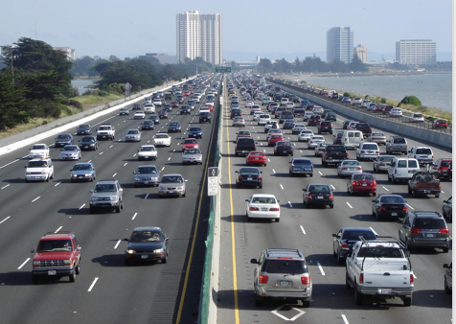
Onroad Mobile Workgroup
Co-leads: Julie McDill (MARAMA), Alison Eyth (EPA OAQPS)
Schedule: Calls 3rd Thursday at 2:00pm ET
Wiki: http://views.cira.colostate.edu/wiki/wiki/9181

Slide 29
Onroad Beta Recap
About a dozen state and local agencies submitted activity data for 2016, 2023, and 2028
  EPA allocated submitted activity to SCCs and projected activity for remaining areas
EPA ran SMOKE-MOVES to produce emissions for 2016, 2023, and 2028
  MOVES 2014NEIv2 input databases were reconfigured to 2016, 2023, and 2028 and used to create emission factors
  2016 meteorology and spatial surrogates

Slide 30
2016 Beta U.S. Onroad Emissions
CO (not shown), NOx, and VOC are biggest
Emissions trending down in future

Slide 31
Onroad Workgroup: 2016v1
Approach (Status)
  New state-supplied MOVES input data will be incorporated (ongoing)
  Activity data (VMT and VPOP) will be updated only for states that provided new data for 2016v1 (almost final)
  Hoteling hours will be reduced based on new information (soon)
  Vehicle age distributions to be updated to represent 2016 based on CRC A-115 VIN decode project for 2017 NEI (done)
  Representative counties will be updated to reflect new data (done)
  MOVES will be run to create new emission factors (July/August)
  SMOKE-MOVES will be run using the new emission factors with updated activity to create emissions (July base, August future)
Differences from beta
  Updated inputs will result in impacts at the state and county levels
2016v1 Milestones for base and future years
  Expected review date: August 2019 – as SMOKE-MOVES runs finish
  Expected release date: September 2019

Slide 32
New Onroad Data for 2016v1
NOTE: These are only updates in addition to activity data provided for beta
California: Emissions for 2016, 2023, 2028
Chicago area: 2016 VMT; VPOP; some other MOVES inputs
Colorado: 2014 and 2017 vehicle populations and age distributions
Georgia: 2016 fuel supply and other comments
Maryland: Updates to truck stop data and rep. counties
Massachusetts: 2016 VPOP and VMT
New Jersey: 2016 age distribution and vehicle populations, new rep. counties, 2023 and 2028 age distribution and vehicle populations
Pima Association of Governments: VPOP, age distribution, I/M information for 2016
New York: new rep. counties
Wisconsin: n/c to 2016, ‘23, ‘28; 2020 VMT and VPOP, age distributions; I/M inputs
Louisville area: 2016 county total VMT; ’20, ’23, ‘28 VMT; speed distributions and urban/rural road type splits

Slide 33
Representative County Analysis
Performed review of rep counties based on
  Altitude: high altitude states are Colorado, Nevada, New Mexico, and Utah; all others are low
  State: counties represent others in the same state
  Fuel region: a region of counties sharing similar gasoline fuel – for example, those within a state’s reformulated gasoline (RFG) area
  Inspection and maintenance: no I/M, having I/M, or I/M in base year but not in future year
  Mean light-duty age (years): 0-7, 7-9, 9-11, 11-13, 13-15, 15+
  Percentage of ramps: 0-0.05, 0.05-0.09, 0.09-0.13, 0.13-0.17, 0.17+
Representative counties are only used in continental U.S., not AK & HI

Slide 34
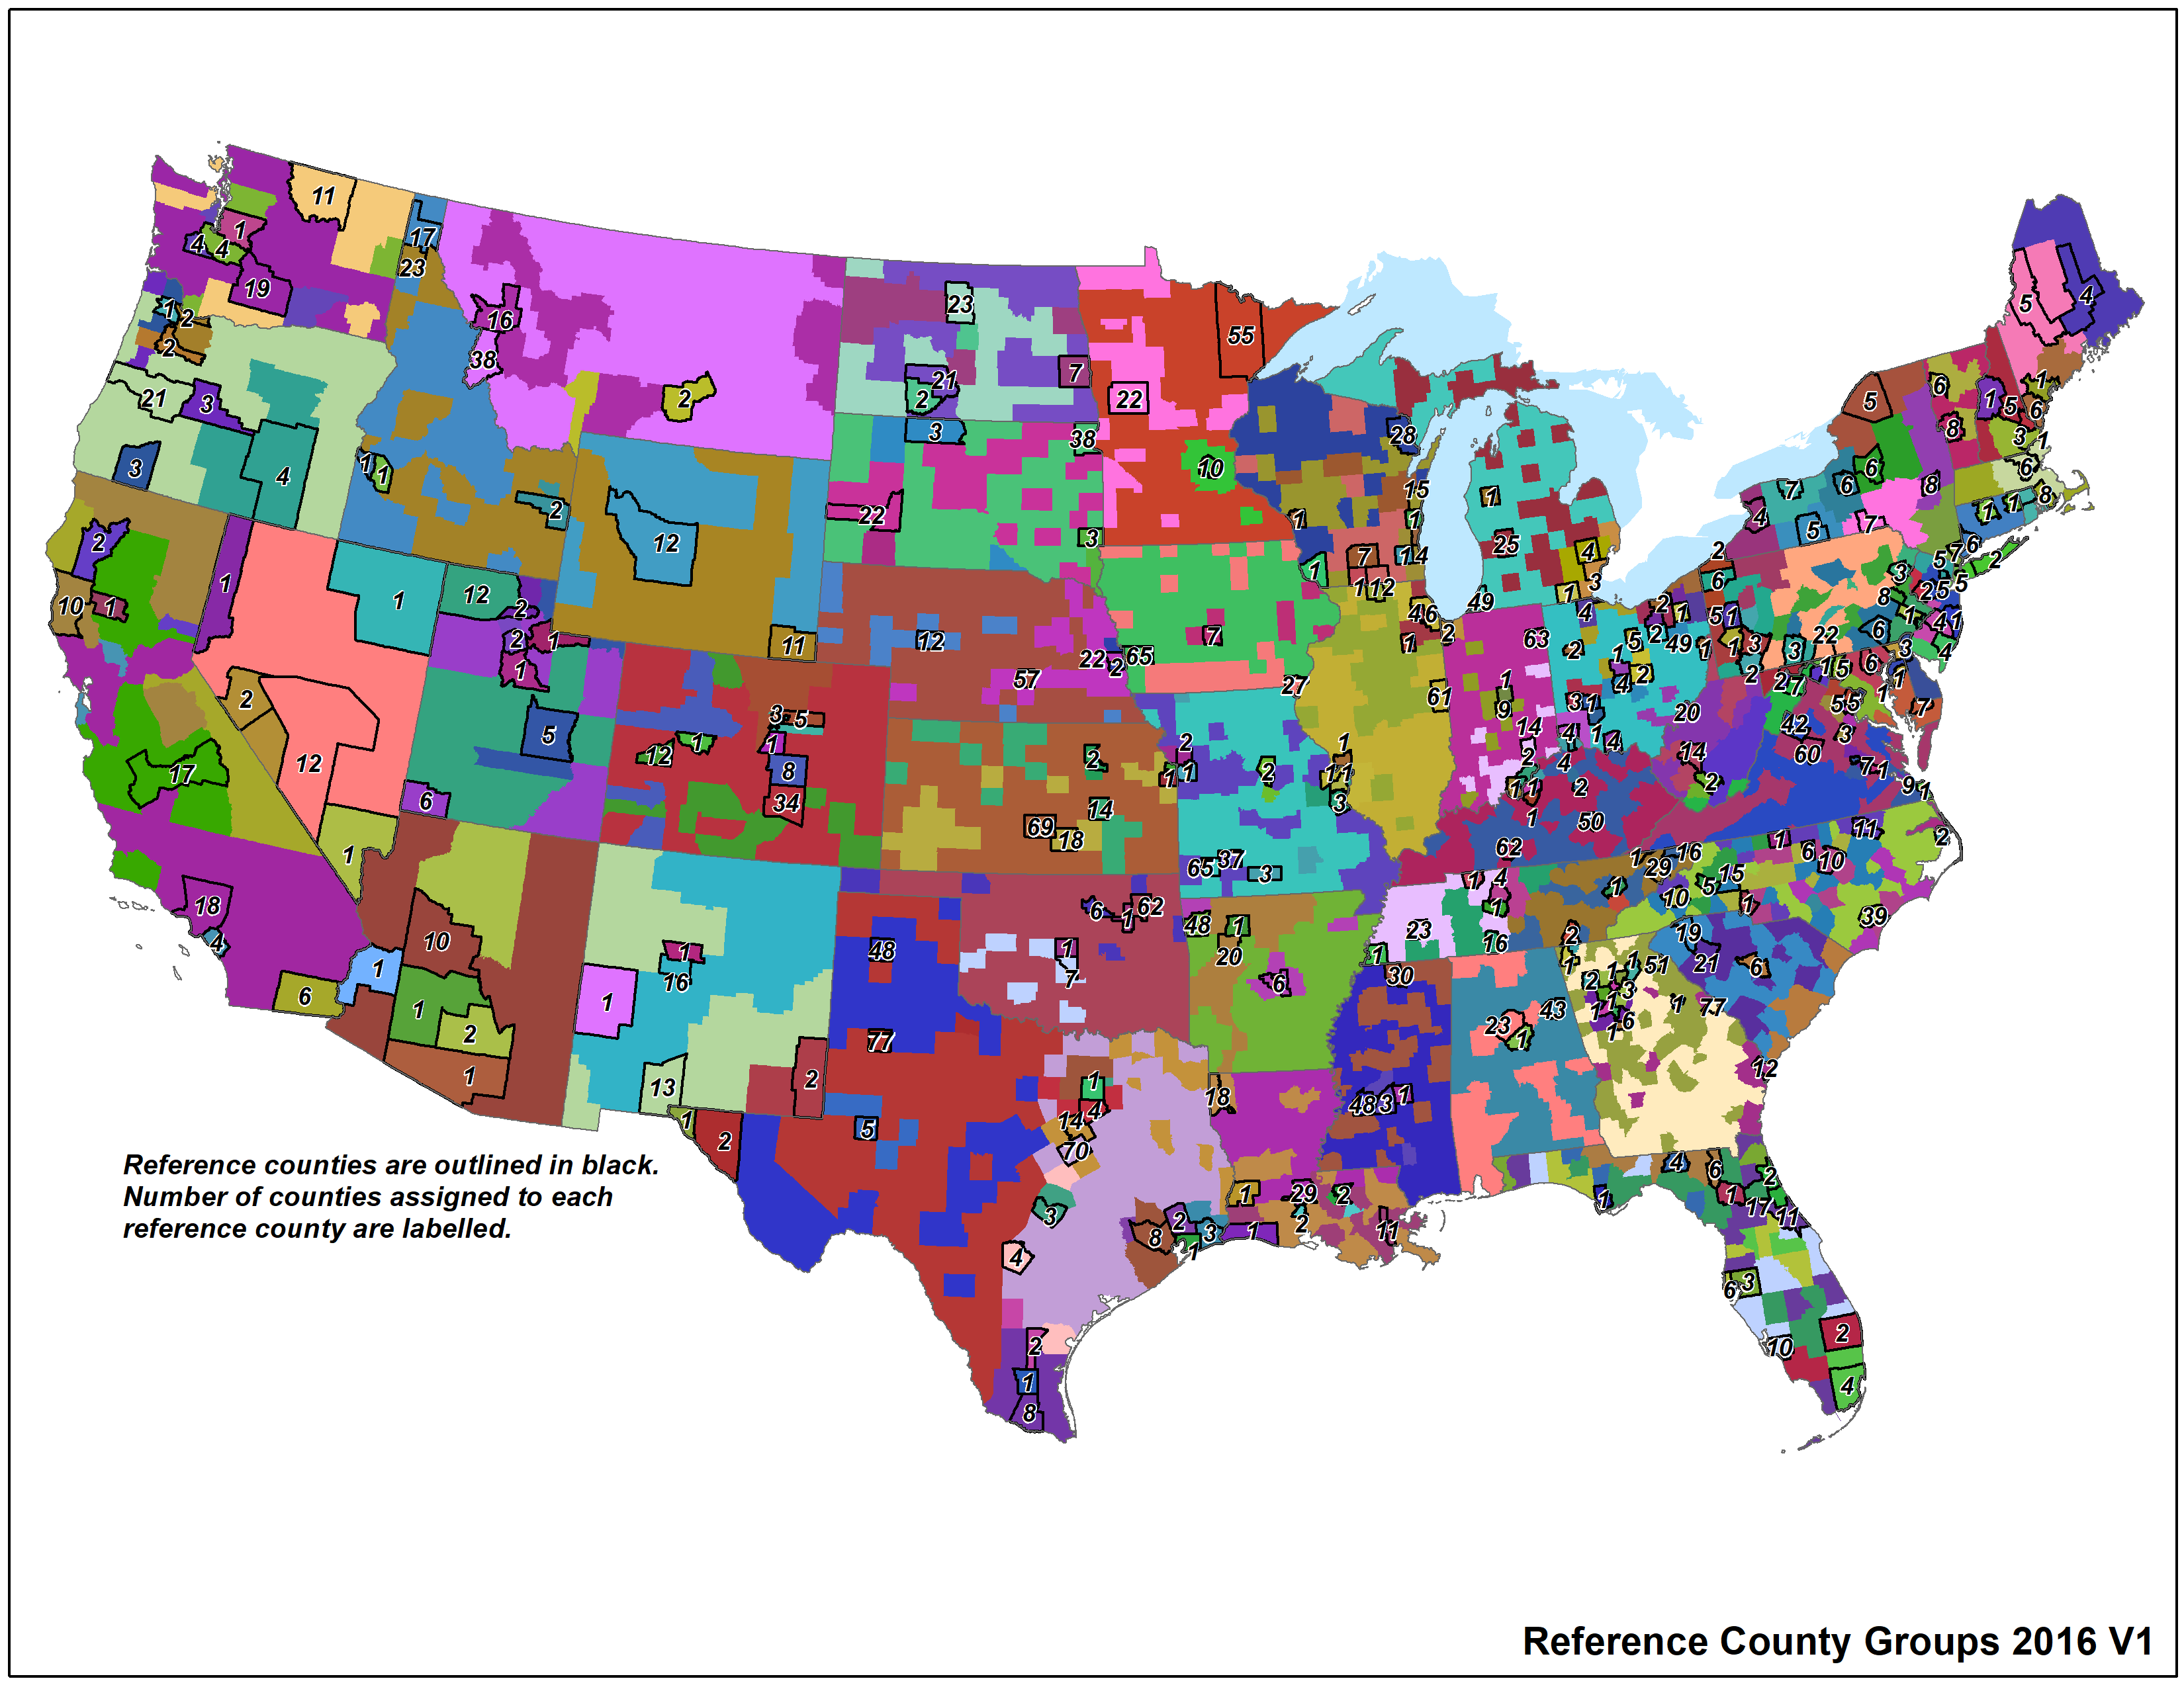
2016v1 Representative Counties
308 representative counties for 2016v1
* Can zoom in on provided file

Slide 35
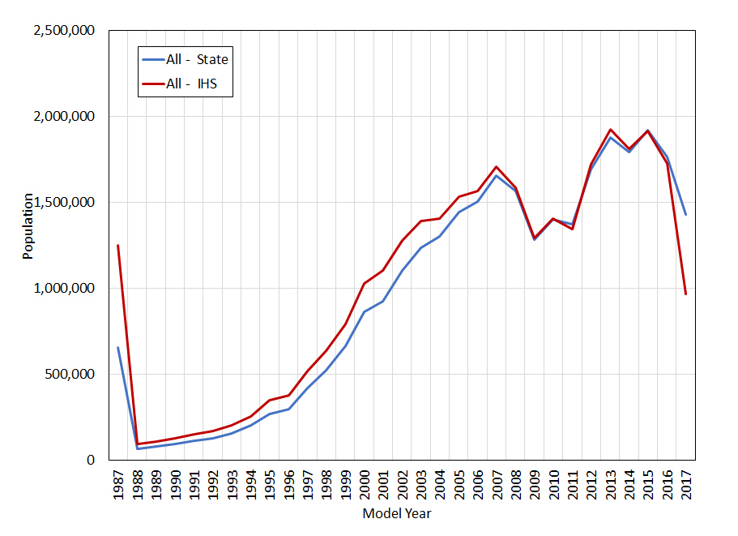
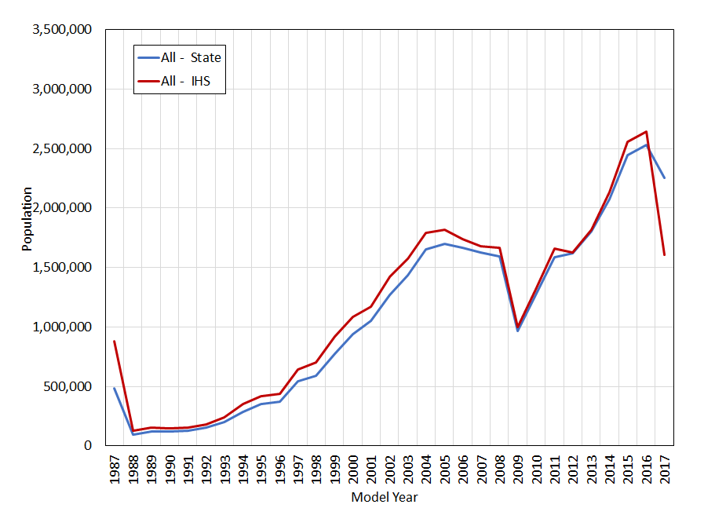
Vehicle Populations by Age
Passenger cars
Passenger and light
commercial trucks
Recession
Recession
An adjustment will be applied in non-submitting states to
account for the difference between the state submittals and the
national data pull using the method developed via CRC A-115

Slide 36
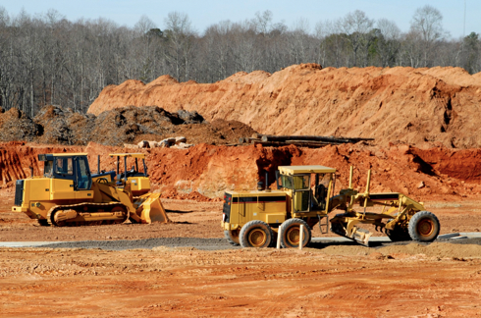
Nonroad Mobile Workgroup
Lead: Sarah Roberts (EPA OTAQ)
Schedule: Calls on 4th Thursday at 3:30pm Eastern
Wiki: http://views.cira.colostate.edu/wiki/wiki/9179

Slide 37
Nonroad Workgroup: 2016v1
Approach
  Run MOVES2014b with state-supplied data and updated factors for allocating Agricultural and Construction equipment
Run Setup
  Reviewed data submitted for 2017 NEI and incorporated into 2016v1 where appropriate, for example:
    Weekend/weekday activity fractions, equipment types in Texas
    Updated equipment populations for TX, CT, Maricopa Co. AZ, UT
    Month and spatial allocations of snowmobiles in Utah
    Recreational marine allocations in Washington
  Updated Georgia fuel supply for 2016
  Zero-out emissions from select equipment sectors in select counties (done in post-processing)
  Temporal (monthly) profiles for Agricultural equipment activity in LADCO states
  Updated Agricultural and Construction equipment allocations to the state- and county-level

Slide 38
Nonroad Workgroup: 2016v1
For beta, ran MOVES2014b using model defaults (no state-supplied data)
Differences between beta and v1 inventories are the result of state-supplied data and work group’s updates to the allocation of Construction and Agricultural equipment
Notes: emissions from Airport Support and Oil Field Equipment are excluded from nonroad inventories.
Above summaries include Puerto Rico and U.S. Virgin Islands.

Slide 39
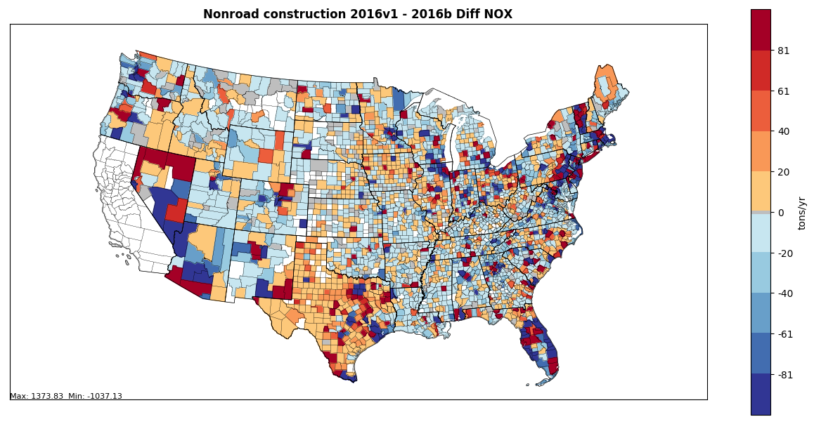
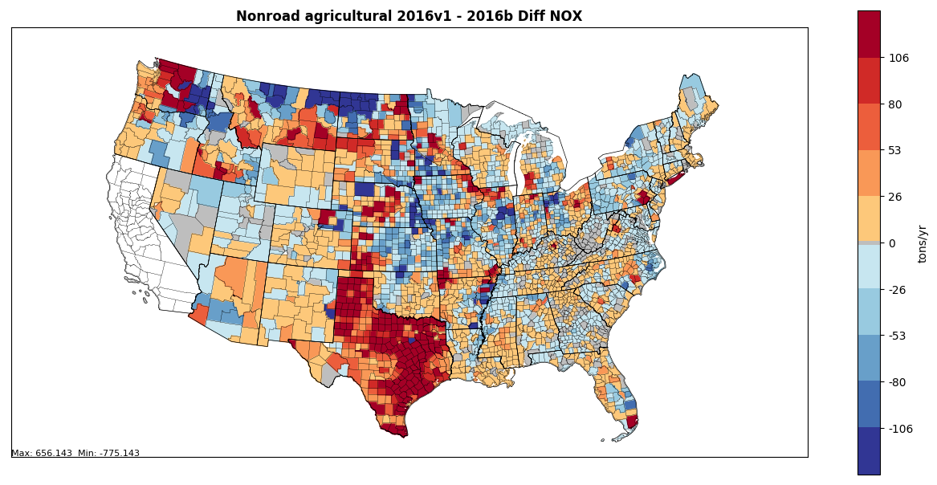
Nonroad Workgroup: 2016v1
County-level differences in NOx inventories (tons): 2016v1 – 2016beta
Construction (top) and Agricultural (bottom) sectors

Slide 40
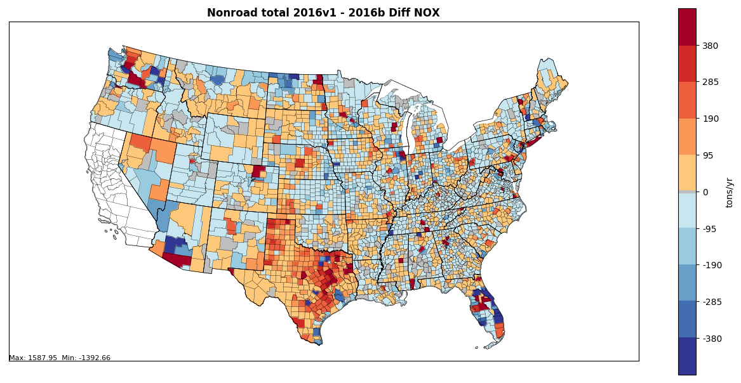
Nonroad Workgroup: 2016v1
Milestones
  2016 run is complete; work group to start reviewing results this week
  Will kick-off future year runs by August, for release in the fall
  Texas to provide emissions based on their TexN tool
County-level differences in NOx inventory (tons): 2016v1 – 2016beta, all equipment sectors

Slide 41
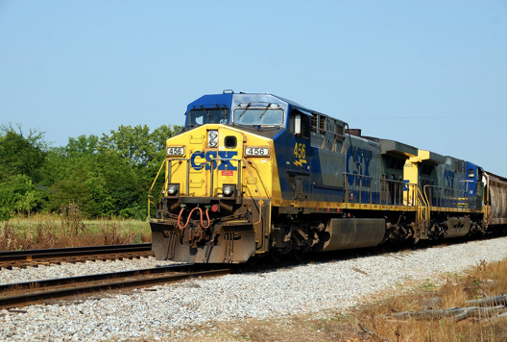
Rail Workgroup
Lead Mark Janssen (LADCO)
Schedule: Calls 3rd Thursday at 11:00am ET
Wiki: http://views.cira.colostate.edu/wiki/wiki/9182

Slide 42
Rail Workgroup: 2016v1
Approach
  Updated growth rates based on new AEO projections
  Include better growth estimates of fleet technology
Differences from beta
  Fixed circular logic in inventory spreadsheets
Milestones
  Expected release date: July 3rd 2019

Slide 43
Rail Workgroup: 2016v1

Slide 44
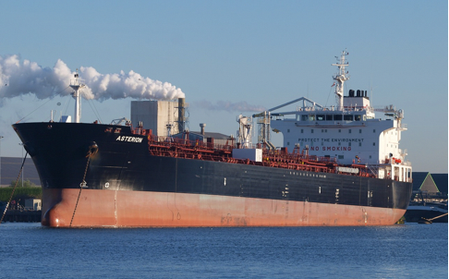
Commercial Marine Vessel (CMV) Workgroup
Lead Mark Janssen (LADCO); update provided by EPA OTAQ
Schedule: Ad hoc; 3rd Tuesday at 3:00pm Eastern
Wiki: http://views.cira.colostate.edu/wiki/wiki/9176
44

Slide 45
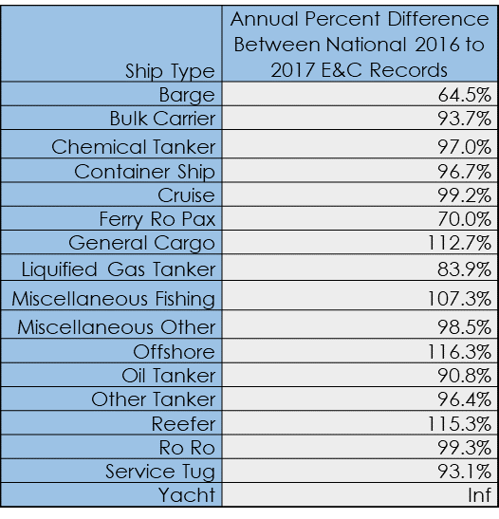
Marine Workgroup: 2016v1
Approach for v1
  Backcast to 2016 the AIS-based CMV inventory being developed for the 2017 NEI
  Adjustments will use USACE Vessel Entrances & Clearances data, by C3 vessel type (see table)
  Will use an aggregate adjustment of 98% for C3 yachts, tugs, barges, fishing vessels, and all C1/C2 vessels

Slide 46
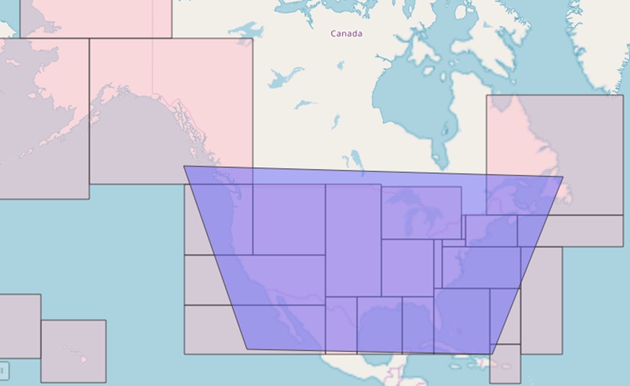
Marine Workgroup: 2016v1
Status of 2016v1: C3 CMV
  C3 emissions based on 2017 AIS data was completed in Oct. 2018
  QA checks completed Feb. 2019
  Documentation completed Dec. 2018
AIS data were pulled from the areas in pink; emissions (tons/year) summed over those areas shown in table

Slide 47
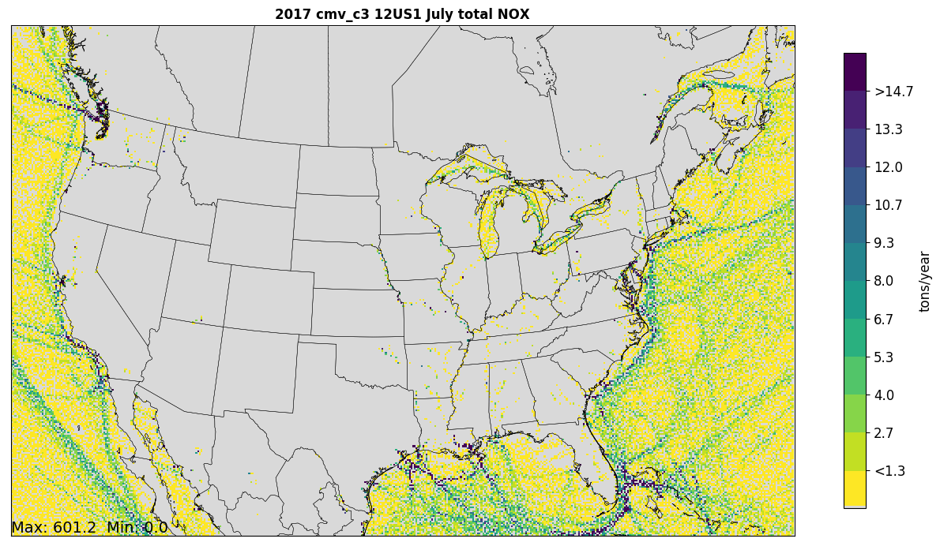
Marine Workgroup: 2016v1
Status of 2016v1: C3 CMV Rasterization
  Separate hourly data files were generated for rasterization
  36-km and 12-km grids (hourly) completed for CONUS
  QAing inland data
  Rasterization of Alaska & Hawaii now underway
  Also developing rasterized data for smaller grids in specific areas (e.g., Great Lakes, Long Island Sound)
Preliminary 12km plot of C3 NOx emissions (July 2017 total)

Slide 48
Marine Workgroup: 2016v1
Next steps for 2016v1CMV inventory
  Run code to calculate C1/C2 emissions
  Rasterize C1/C2 emissions
  Develop C3 and C1/C2 data for NEI annual emissions for NEI shapefiles (port and underway)
  Reconcile C3 and C1/C2 with Canadian CMV inventory
  Gapfill portions of 36km domain not covered by AIS data selection (small portions of AK, HI, St. Lawrence Seaway)
  Adjust 2017 inventory for 2016
  Documentation
  Aiming for fall release

Slide 49
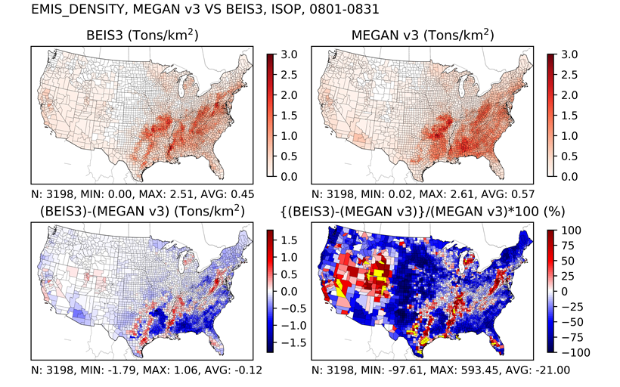
Biogenic Workgroup
Co-leads: Doug Boyer (TCEQ), Jeff Vukovich (EPA)
Schedule: Calls on 4th Tuesday at 2pm ET
Wiki: http://views.cira.colostate.edu/wiki/wiki/9172

Slide 50
Biogenic Emissions Workgroup
Approach
  Using Environment Canada’s BELD4 1km resolution dataset to update landuse for their country
    Only able to update landuse for Biogenic Emissions Inventory System version (BEIS3)
  No changes for Model of Emissions of Gases and Aerosols from Nature (MEGAN3) version 3 planned for 2016v1
Comments on beta
  None received
Differences from beta
  For Canada, the 17 MODIS landuse types are begin replaced by 92 different BELD4 landuse types from Environment Canada
  Canadian landuse changes will result in significant changes in VOC emissions and some impact on biogenic NOx emissions

Slide 51
Biogenic Emissions Workgroup
Milestones
  Expected review period: June – July 2019
  Expected release date: July 31, 2019
Other related activities
  Investigating the possible evaluation of both biogenic emissions models for summer 2013 using observed emissions flux data available for this time period
Emission Inventory Conference Presentation
  7/31 ~10:20 AM CDT

Slide 52
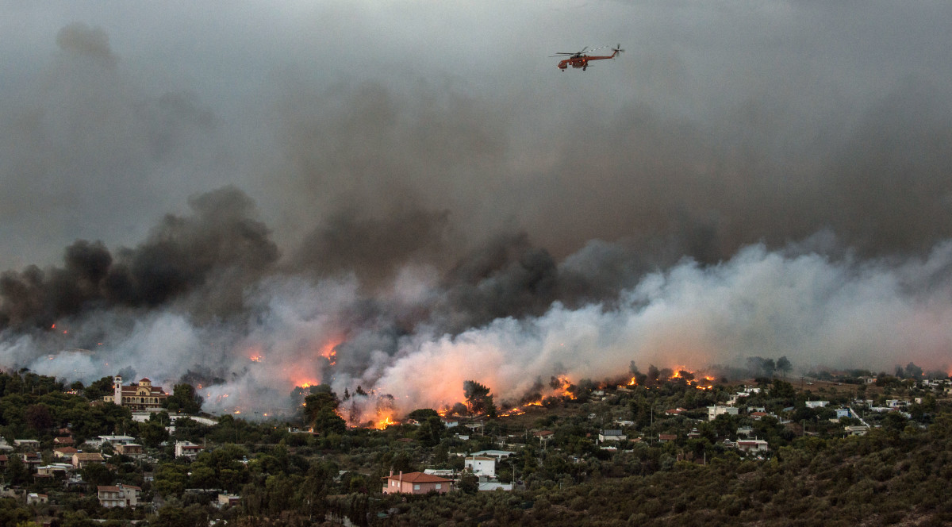
Fires Workgroup
Co-leads: Jeff Vukovich (EPA)
Schedule: Calls on 1st Thursday 1PM ET
Wiki: http://views.cira.colostate.edu/wiki/wiki/9175
Includes wildfires, prescribed fires and agricultural burns

Slide 53
Fires Emissions Workgroup
Approach
  Implement newly acquired Fire information databases
    US Forest Service FACTS: prescribed burns [shapefiles]
    US Fish and Wildland Service (USFWS): wildfire and prescribed
    New Jersey: wildfire and prescribed
    Georgia: day-specific ag burns (beta used month-specific)
  Clean up obvious duplicate and bad fire information
Comments on beta
  PM2.5 emissions possibly too high for Soberanes fire on July 26th
  New Jersey and Alaska wildfire and Rx burn information submitted
  GA submitted day-specific ag burn information

Slide 54
Fires Emissions Workgroup
Differences from beta
Overall wildfire and prescribed burn acres burned up from 17M acres (beta) to 17.5M acres
  Prescribed acres burned up from 11.4M (beta) to 12M
  Wildfire acres burned down from 5.61M (beta) to 5.48M
    Deleted bad or duplicate fire information for major wildfires
  Largest changes in acres burned are in CA, CO, SD, and OR
Minor updates to agricultural fires
Milestones
  Expected review period: July 5, 2019
  Expected release date
    CONUS fires: August, 2019
    Alaska fires: August, 2019

Slide 55
International Emissions
Environment and Climate Change Canada provided year 2015 data and factors to adjust to future years
  Suspiciously high PM was noticed in Alberta / Saskatchewan and Canadians agreed
  Adjustments to PM in these areas were developed
Mexico
  EPA made a concerted effort to reach out to SEMARNAT about their 2016 inventory
  SEMARNAT has not yet provided the 2016 inventory
  CARB noted that summary information for their 2016 inventory is posted on the SEMARNAT website
    It’s possible that adjustments can be computed from this to create an interim modeling inventory

Slide 56
Emissions Modeling Workgroup
Co-leads: Eric Zalewsky (NY DEC), Zac Adelman (LADCO)
Schedule: Calls on 4th Thursday at 3:00pm Eastern
Wiki: http://views.cira.colostate.edu/wiki/wiki/9190

Slide 57
Emissions Modeling Workgroup
Approach: To test and help document the Collaborative emissions modeling platforms
Work on 2016beta
  NY DEC air quality modeling: MEGAN vs BEIS, IPM vs ERTAC, CMAQ vs CAMx
  LADCO reviewing the inventory data and ancillary profiles
  Beta release documentation review/editing

Slide 58
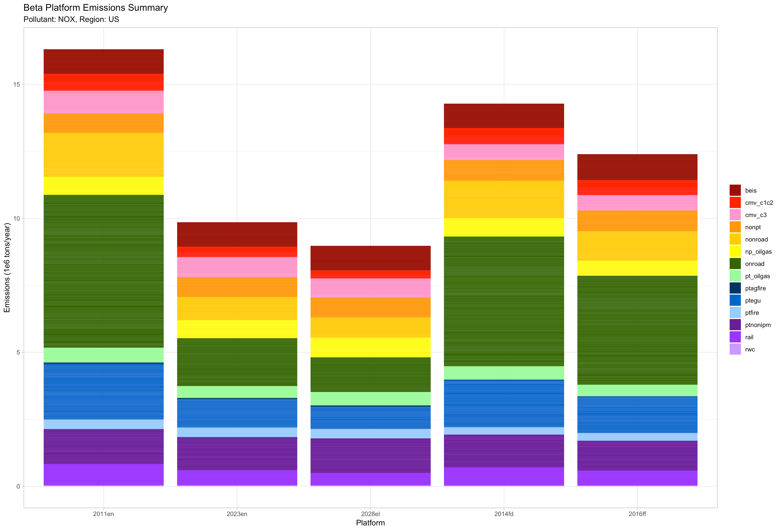
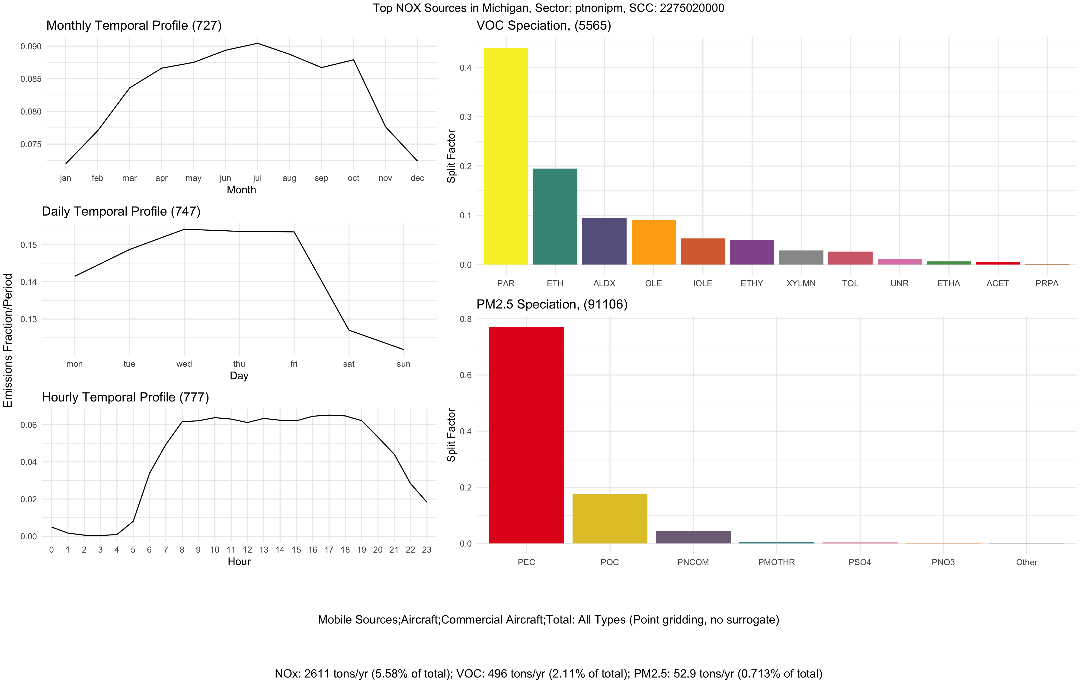
Emissions Modeling Workgroup
Standardized plots available from LADCO
  https://www.ladco.org/technical/modeling-results/2016-inventory-collaborative/
Mapping/chart tool available at IWDW
  http://vibe.cira.colostate.edu/iwdwx/Emissions/2016EMP

Slide 59
Emissions Modeling Workgroup
Approach for v1: The same as for beta
  Review/edit documentation
  Test platform scripts
  Plot emissions results
  Compare v1 to beta and previous national modeling platforms

Slide 60
EPA-State 2016 Model Evaluation Forum
Goal of Forum
  To promote collaboration with state partners on characterizing and understanding model performance and identifying performance issues for possible further research by EPA and/or the modeling community and to serve as a venue for sharing data and evaluation results
Membership: 92 members
  2 members from Environment Canada
  25 members from EPA
  4 members from BLM and NPS
  45 members from 25 states
  8 members from 4 local air agencies
  8 members from MJOs
Recent and upcoming meetings
  March 15 MJO call – announced forum formation and solicited participation
  May 2 – Initial Forum Call with rollout of forum charter, Sharepoint site and available data/plots.
    55 participants from EPA, Environment Canada, National Park Service, MJOs, states and local air agencies.
  May 30 – Webinar on meteorology and emissions inputs for 2016 beta simulations (Alison Eyth, Zac Adelman, Chris Misenis)
  Monthly forum meetings are being scheduled starting in June. At the June meeting we hope to solicit participation and formalize working teams on specific topics of shared interest.

Slide 61
EPA-State 2016 Model Evaluation Forum
Disk drive with model inputs and outputs has been sent to the Inter-mountain West Data Warehouse (IWDW)
Extensive work to create and publicly disseminate comprehensive set of model evaluation plots (>50,000 plots)
  Plots transferred from EPA to LADCO’s public plot viewer: https://www.ladco.org/technical/modeling-results/epa-2016-modeling
  Plots available for ozone, PM species, HNO₃, CO, NO, NO₂, NO_{x}, NO_{y}, SO₂ split out by NOAA climate region and season
SharePoint site where forum members can access information about the forum, the model simulations, past and upcoming meetings, available data, discussion board, and wiki page

Slide 62
Inventory Collaborative Next Steps
Workgroups will finalize version 1.0 of the 2016 inventory by September 2019; including projections to 2023 and 2028
Collecting information on prospective uses of the v1 platform: let us know
Quarterly outreach calls by the Collaborative to report out on progress: mark your calendar
Next outreach call:
September 26, 2019 at 12:00 Eastern

Slide 63
Inventory Collaborative Wiki
These slides, answers to the questions posed during this webinar, notes:
http://views.cira.colostate.edu/wiki/wiki/10198
Main National Inventory Collaborative Wiki includes live workgroup wikis, documentation, calendar:
http://views.cira.colostate.edu/wiki/wiki/9169
LADCO Plot Viewer
https://www.ladco.org/technical/modeling-results/2016-inventory-collaborative/
IWDW Interactive Plotting Tool
http://vibe.cira.colostate.edu/iwdwx/Emissions/2016EMP

